Slide 1
An Empirical Analysis of Anonymity in Zcash
USENIX 2018
George Kappos, Haaroon Yousaf, Mary Maller, and Sarah Meiklejohn
University College London

Slide 2
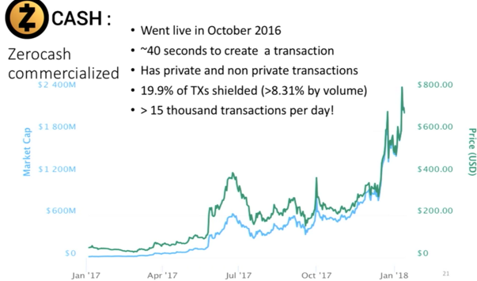

Slide 3
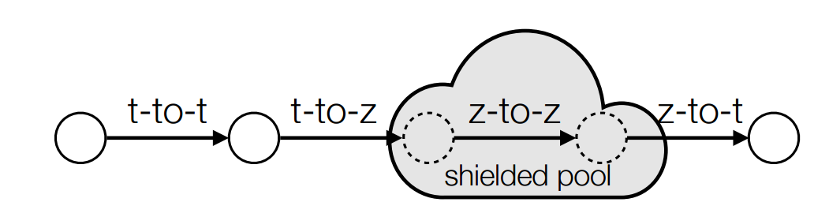
Zcash (ZeroCash)
IEEE S&P 2014
Bitcoin Fork
Shielded Pool
Zero-knowledge Proofs
Spend coins without revealing which coins are being sent
t: transparent
z: shielded address
Notes:
About 1155.61 RMB now 20180622

Slide 4
Research Question
Is Zcash really more privcacy-preserving?
Who are its main participants?
Adapt analysis that already developed for Bitcoin
Who are interacting with the shielded pool?
What’s in the pool?
Case study of Shadow Brokers
Conclusion

Slide 5
Zcash ecosystem
1block 12.5 ZEC
2.5 -> Founders (address in Zcash chain parameters)
10 -> Miner
Coins Must be deposited into the shielded pool at least once
All coins have been shielded at least once

Slide 6
Data & Method
Zcashd client
Load to Apache Spark
Python scripts with PySpark
https://github.com/manganese/zcash-empirical-analysis
Data 2018/01/21

Slide 7
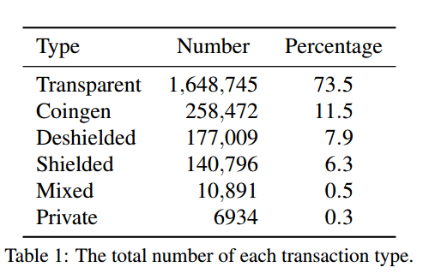
General Blockchain Statistics

Slide 8
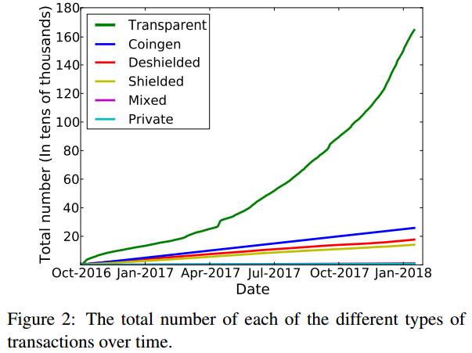
General Blockchain Statistics

Slide 9
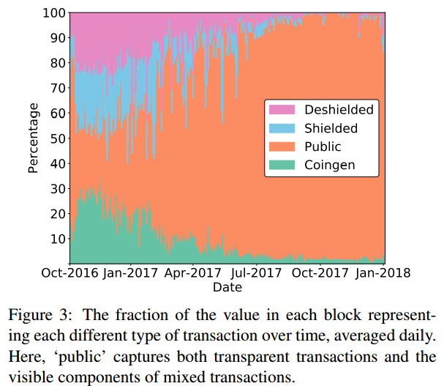
General Blockchain Statistics

Slide 10
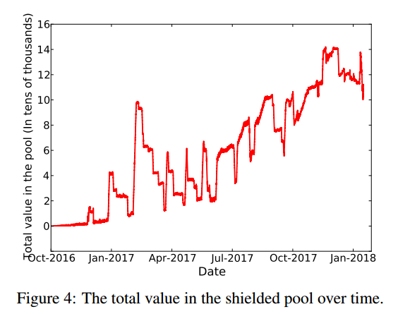
General Blockchain Statistics

Slide 11
T-Address Clustering
Heuristic 1. If two or more t-addresses are inputs in the same transaction, then they are controlled by the same entity.
Heuristic 2. If one (or more) address is an input t-address in a vJoinSplit transaction and a second address is an output t-address in the same vJoinSplit transaction, then if the size of zOut is 1 (i.e., this is the only transparent output address), the second address belongs to the same user who controls the input addresses.
Notes:
(whether that transaction is transparent, shielded, or mixed),

Slide 12
T-Address Clustering Result
560,319 Clusters
97,539 more than single address
Exchanges and wallets

Slide 13
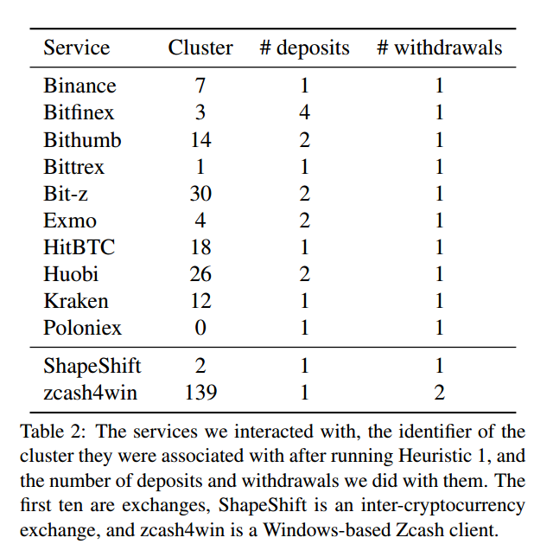
T-Address Clustering Result
560,319 Clusters
97,539 more than single address
Exchanges and wallets

Slide 14
T-Address Clustering Result
560,319 Clusters
97,539 more than single address
Exchanges and wallets
Where bought
ShapeShift heavily used
Mining pools and founders
Reuse same small set addresses
Philanthropists

Slide 15
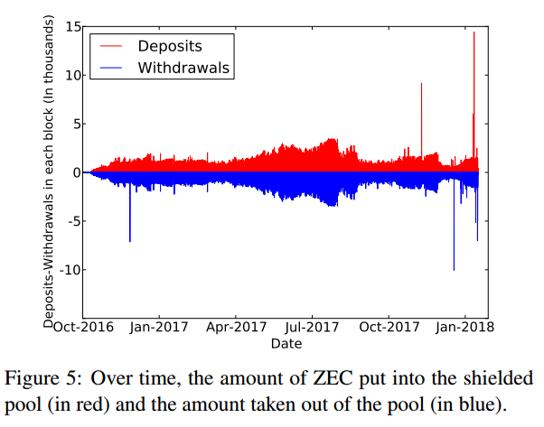
Interactions with the Shielded Pool

Slide 16
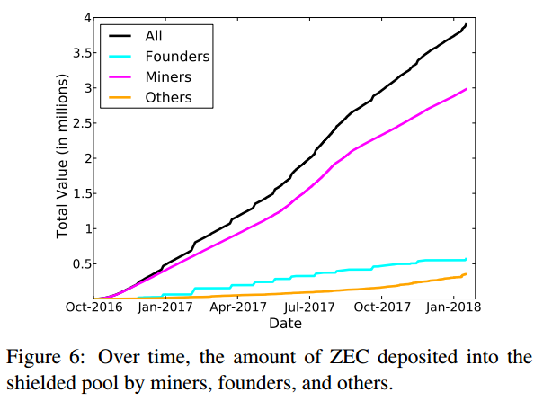
Interactions with the Shielded Pool
Notes:
Miner: coingen

Slide 17
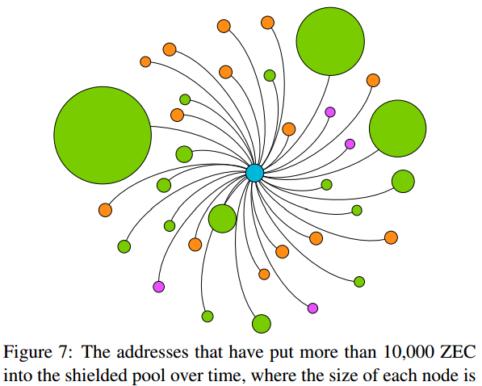
Interactions with the Shielded Pool
Size: proportional to the value
Green: miners
Orange: founders
Purple: Unknown

Slide 18
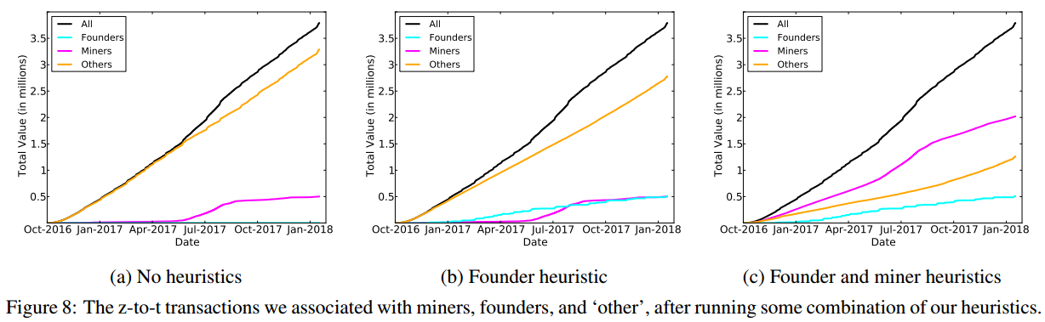
Interactions with the Shielded Pool z-to-t transaction Attribution
a: same addresses are used 13.3%

Slide 19
Interactions with the Shielded Pool z-to-t transaction Attribution
Heuristic 3. Any z-to-t transaction carrying 250.0001 ZEC in value is done by the founders.

Slide 20
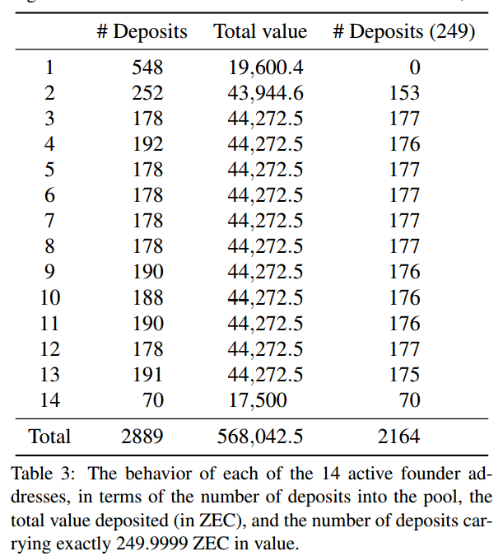
Interactions with the Shielded Pool z-to-t transaction Attribution
249.9999 ZEC in
250.0001 ZEC out count:1953
6-10blocks intervals count:1943

Slide 21
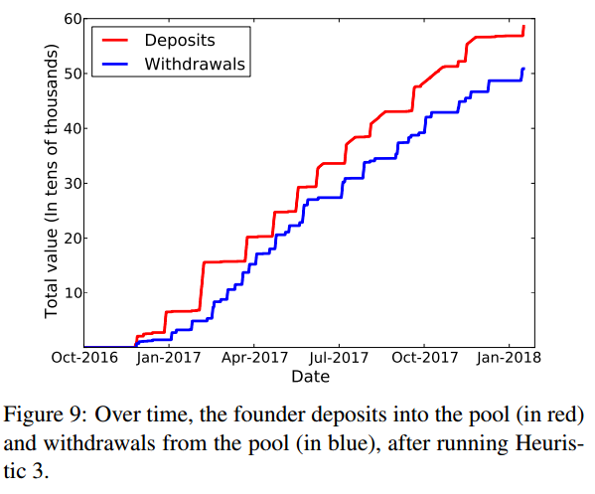
Interactions with the Shielded Pool z-to-t transaction Attribution

Slide 22
Interactions with the Shielded Pool z-to-t transaction Attribution
Heuristic 3. Any z-to-t transaction carrying 250.0001 ZEC in value is done by the founders.
Heuristic 4. If a z-to-t transaction has over 100 output t-addresses, one of which belongs to a known mining pool, then we label the transaction as a mining withdrawal (associated with that pool), and label all non-pool output t-addresses as belonging to miners.

Slide 23
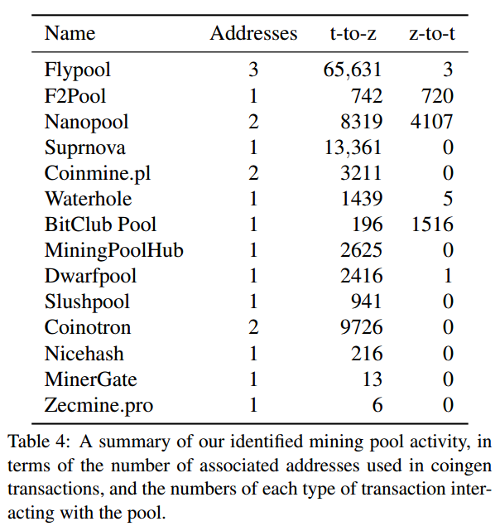
Interactions with the Shielded Pool z-to-t transaction Attribution
Notes:
Coingen->miner address

Slide 24
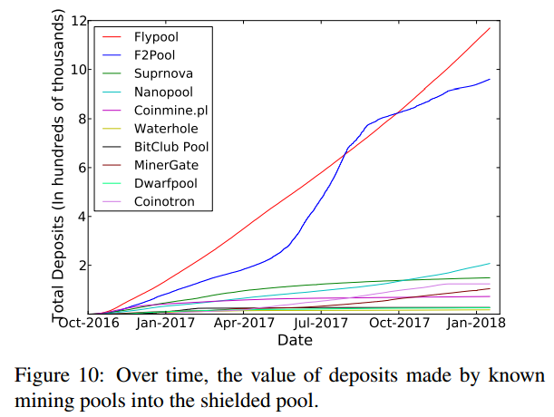
Interactions with the Shielded Pool z-to-t transaction Attribution
110,918 addresses belong to miners

Slide 25
Interactions with the Shielded Pool z-to-t transaction Attribution

Slide 26
Interactions with the Shielded Pool z-to-t transaction Attribution - Other
Heuristic 5. For a value v, if there exists exactly one t-to-z transaction carrying value v and one z-to-t transaction carrying value v, where the z-to-t transaction happened after the t-to-z one and within some small number of blocks, then these transactions are linked.

Slide 27
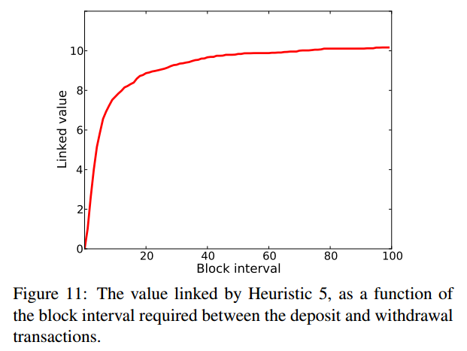
Interactions with the Shielded Pool z-to-t transaction Attribution - Other
12,841 unique values
9,487 had 8 decimal places
Linked 12,841 transactions
28.5% of all coins
87% belong to founders and miners

Slide 28
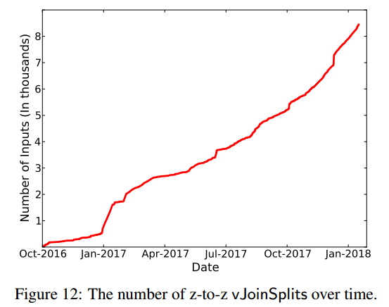
Interactions in the Shielded Pool
6,934 z-to-z transactions
We know:
miner’s fee
Time
Number of vJoin-Splits used as input
Small number of users making many transactions
201701: possible belong to the same group

Slide 29
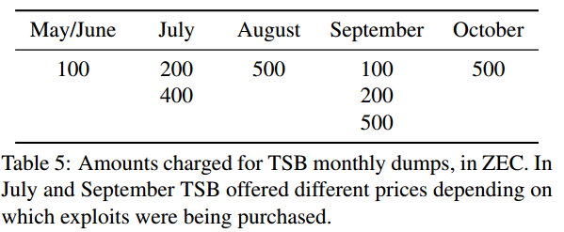
Case Study: The Shadow Brokers
Look up all t-to-z transactions :
Not founder or miners
100, 200, 400 or 500 ZEC ±5

Slide 30
Case Study: The Shadow Brokers
Potential customer:
Not get funds from the pool
Not a frequent user (transactions <=250)
Money equal to corresponding price ±1ZEC

Slide 31
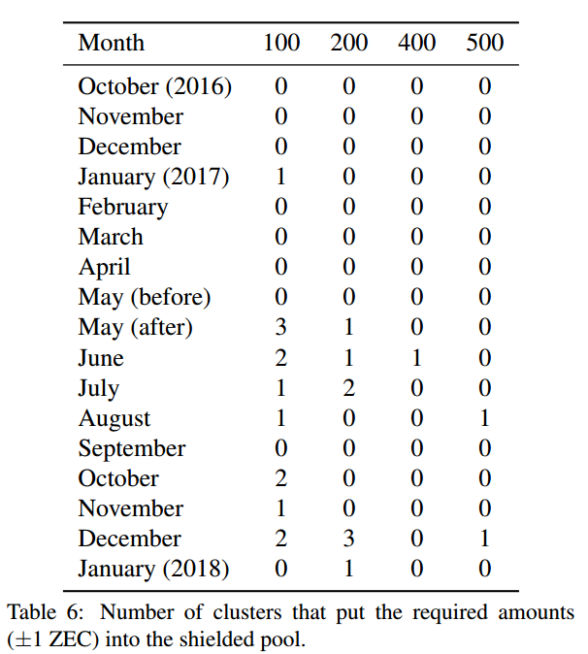
Case Study: The Shadow Brokers

Slide 32
Case Study: The Shadow Brokers
Exact Match One
June: 100ZEC
July: 200ZEC
August: 500ZEC
a new user
most money came directly from Bitfinex

Slide 33
Conclusion
First in-depth exploration of Zcash
Clustering heuristics (for Bitcoin)
Attribution heuristics
Most user not taking privacy feature advantage
Shrinking the overall anonymity set
Eroding anonymity of other users

Slide 34
Future Work
Classify more z-to-z by:
Analyzing the time intervals
Examining other metadata(miner fee, size of transaction)
Behavior of mining pools
Actively interacts with them

Slide 35
Suggestions
Founders’ pattern
Require all transaction in shielded pool
Cryptographic techniques advances
Mainstream wallet support z-address

